Slide 1

Drones for computer vision applications
Lukas Beierl, Erwin Grenz, Nadir Hussain
Group 3
(Summer School), (E24)
16.08.2024

Slide 2
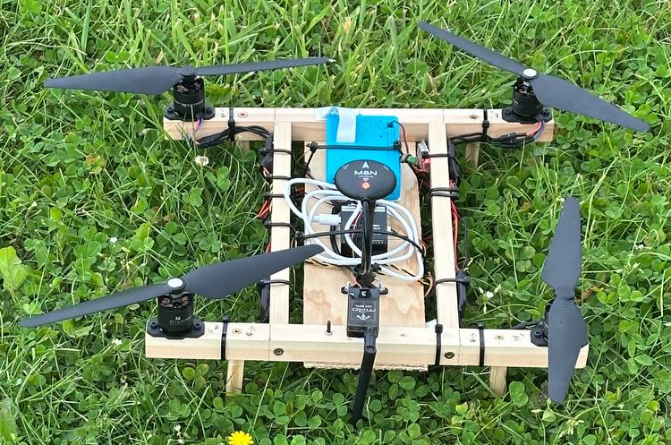
Agenda
Construction
Computer Vision
Safety and regulations
Ethics reflections
Conclusion
Slide 1 Group 3 – 16.08.2024

Slide 3
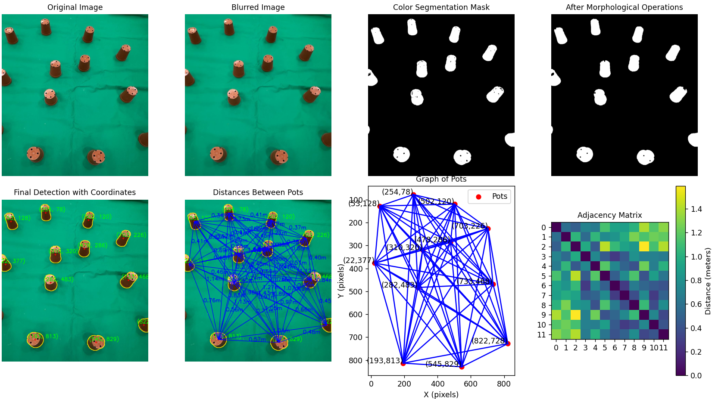
Computer vision
Example
Github: https://github.com/GIT057/Drones-for-Computer-Vision-applications
Slide 1 Group 3 – 16.08.2024

Slide 4
Computer vision
Example
Github: https://github.com/GIT057/Drones-for-Computer-Vision-applications
Slide 1 Group 3 – 16.08.2024

Slide 5
BACK-UP

Slide 6
Template-Title
Subtitle
Text
Picture
Slide 1 Group 3 – 16.08.2024

